Slide 1
Is earning your CFRE on your New Year’s resolution list?
Angie Herting
Director of Development
Southwest Wisconsin Technical College

Slide 2
The Application
Education – 80 points in CFRE approved continued ed credits in past 5 years, Service learning (up to 10 points), academic degrees from any year.
Professional Practice – 36 points – earn 1 point for each month of employment as a fundraiser in past 5 years
Professional Performance – 55 points
1 point for each $25,000 raised
5 points for each specific communications activity or project with measurable outcomes or results
5 points for each specific program, institutional or financial management activity or project which impacted your fundraising activities

Slide 3
A fundraising professional who has met the eligibility requirements to sit for the exam should have the knowledge to pass the exam

Slide 4
The Cost
Examination fee of $700 for organization members and $875 for non-members
Plus study materials

Slide 5
Exam Overview
Exam is designed to assess six core areas of knowledge:
Current and Prospective Donor Research
15%
Securing the Gift
22%
Relationship Building
29%

Slide 6
Exam Overview
Volunteer Involvement
6%
Leadership and Management
18%
Ethics, Accountability and Professionalism
10%

Slide 7
The Exam
200 multiple choice questions (four options)
Two sections each with 100 questions with a ten-minute break
4 hours to complete the exam
25 questions will not count toward your score
Computer based with virtual and in-person options

Slide 8
After the Exam
You will receive your score immediately upon completing the exam
The overall pass rate is approximately 70 – 80%
CFRE International does not permit access to or release answer sheets, test booklets, or previously ‘used’ exams
Candidates who do not pass the exam are eligible for two (2) re-exam attempts per application in a 12-month period

Slide 9
Recertification
Education: 45 points – Includes- Continuing Education, Authoring, Academic Degrees earned, Service Learning
Professional Practice: 30 points - earn 1 point for each month of employment as a fundraiser
Professional Performance: 40 points - Actual funds raised where 1 point = 25,000 raised in US Dollars

Slide 10
Resources
Candidate Handbook - CFRE International
Resource Reading List - CFRE International
CFRE Exam Compass Study Guide - CFRE International
Flash cards: cfre.org /study-aids
Glossary - CFRE International
CFRE Exam Study Plan Template - CFRE International
Practice Exam - CFRE International
Study Groups - CFRE International

Slide 11
Questions?

Slide 12
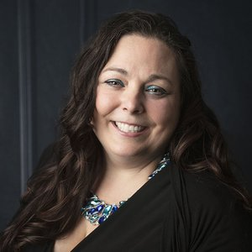
Thank you
Angie Herting
563-564-0320
Angie.herting@gmail.com
Aherting@swtc.edu

